Slide 1
Digital Portfolio
STUDENT NAME: AMRITHA P.P
REGISTER NO AND NMID: asbruce2428c0544
DEPARTMENT: BSC AI & ML
COLLEGE: JCT COLLEGE OF ARTS & SCIENCE/BHARATHIAR UNIVERSITY

Slide 2
PROJECT SIMPLE PORTFOLIO WEBSITE

Slide 3


AGENDA
Problem Statement
Project Overview
End Users
Tools and Technologies
Portfolio design and Layout
Features and Functionality
Results and Screenshots
Conclusion
Github Link
3/21/2024 Annual Review

Slide 4

PROBLEM STATEMENT
Many professionals, especially web developers and designers, need an easy way to showcase their work through a personal portfolio website. However, creating a custom portfolio can be time-consuming and technically challenging. Existing solutions like website builders or templates often limit creativity and come with ongoing costs or complexity.
There is a need for a simple, self-contained, and customizable portfolio solution that allows users to:
Easily showcase their skills and projects.
Maintain full control over design and content.
Use only basic web technologies (HTML, CSS, JavaScript) to ensure simplicity and speed.
Update content without requiring advanced technical knowledge or external tools.
This portfolio website would enable professionals to create a responsive, lightweight, and easily customizable online presence without relying on third-party services.

Slide 5

PROJECT OVERVIEW
This project aims to create a simple, self-contained portfolio website using only HTML, CSS, and JavaScript. The goal is to provide developers, designers, and other professionals with an easy way to showcase their work, skills, and experience through a personalized, responsive, and interactive website.
The website will include sections for:
Home: A brief introduction and overview.
About: Personal bio and professional highlights.
Projects: A display of selected work and projects with descriptions.
Contact: A simple contact form with basic validation.
Key features of the website include:
Responsiveness: The layout will automatically adjust to different screen sizes (mobile, tablet, desktop).

Slide 6

WHO ARE THE END USERS?
🎯 Common End Users of a Portfolio Website
Potential Employers or Recruiters They visit to evaluate your skills, experience, and past work before offering interviews or jobs.
Clients or Customers If you're a freelancer, designer, developer, or artist, clients use your portfolio to decide whether to hire you for a project.
Collaborators or Peers Other professionals might explore your work to consider partnerships, collaborations, or networking opportunities.
Fans or Followers If your work is creative—like photography, writing, or illustration—fans may visit to appreciate your style and stay updated.
Academic Institutions If you're applying for a program or grant, universities or committees might review your portfolio as part of your application.
You (the Creator) It’s also a personal tool for self-reflection, tracking growth, and showcasing achievements.

Slide 7

TOOLS AND TECHNIQUES
HTML – for structure and content (e.g., headings, buttons, sections)
CSS – for styling (e.g., colors, layout, fonts)
JavaScript – for interactivity (e.g., switching sections, animations)
These are all written directly inside the <html> file using:
<style> tag for CSS
<script> tag for JavaScript

Slide 8
POTFOLIO DESIGN AND LAYOUT
Portfolio design and layout is all about how you present your work — whether you're a designer, developer, artist, or student. It’s like creating a personal website or document that shows off your best projects, skills, and achievements.
🧠 Why It Matters:
A good design makes your portfolio look professional and attractive.
A smart layout helps people easily find what they’re looking for — like your bio, projects, or contact info.
Together, they help you stand out and make a strong impression.
8

Slide 9
FEATURES AND FUNCTIONALITY
Home Page: A welcoming intro with your name, title, and a snapshot of your work.
About Section: A short bio, your skills, and maybe a photo.
Project Gallery: Visual thumbnails or cards showcasing your best work.
Project Details: Clickable pages or popups with deeper info about each project.
Contact Form: A way for visitors to reach out directly.

Slide 10
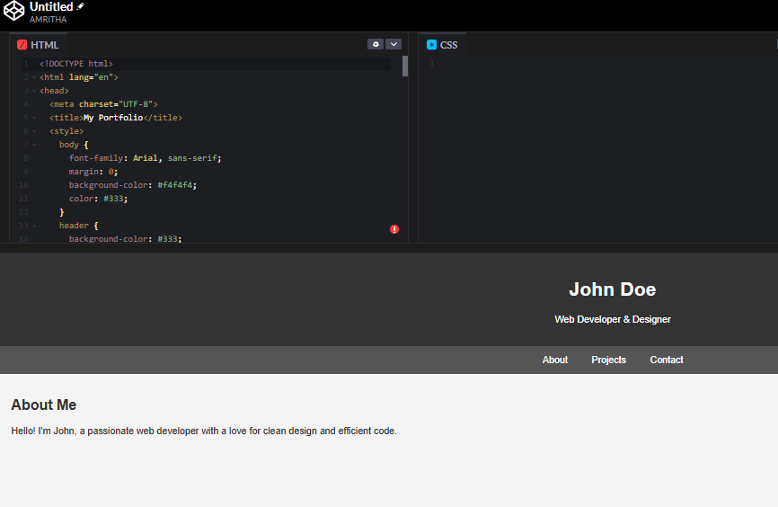

RESULTS AND SCREENSHOTS
3/21/2024 Annual Review
10

Slide 11
CONCLUSION
A well-crafted portfolio design and layout is more than just a showcase — it’s your personal brand in action. By combining clear structure with thoughtful visuals, you create a space that highlights your skills, tells your story, and leaves a lasting impression. Whether you're aiming to land a job, attract clients, or simply share your creative journey, your portfolio is your digital handshake — make it count.
11

